Slide 1


Automation Testing
RLL PROJECT

Slide 2

Demo Web Shop
Team Lead - Asish Patra (2575431)
Team members:
Shaik Muthahar (2575824)
Sindhu R (2576030)
Ananya Shukla (2577138)
Peddi Chakrapani (2576374)
Arpita Joshi (2576822)
Aitha Sharath Kumar (2576107)
Rangolu Joshnitha (2576883)
Dikshansh Shukla (2576288)

Slide 3

Agenda
Introduction
Objectives
Test Scenarios
Technologies
Feature Files
Gherkin Keywords
Screenshots
Outcome
Conculsion

Slide 4

Introduction
Website testing is an umbrella term for processes which test websites for unwanted defects and issues across a broad range of devices. It includes functionality, usability, accessibility and performance testing. Issues are widely regarded as the ‘conversion killers’ of the online world. If your website’s functionality does not work as it should, if it crashes or throws up a 404 error or is hampered by slow load speeds, your visitors won’t hang around on your site
02

Slide 5
Test Scenarios
Navigate to the URL, click on the Register. Fill in the personal details to register. Validate the successful registration.
Navigate to the URL, enter search keyword, and click the search button. Read the search keyword from excel sheet.
Navigate to the URL, validate the community poll, with login, without login, poll for more than one time.
Navigate to the URL, click on the book, confirm all the books having “AddToCart” button.
Navigate to the URL ,click on the book, confirm all the books into cart. Validate the book is successfully added to the Cart.
Navigate the the URL, click on the book, add the third book into cart. Complete checkout process and validate the same.

Slide 6
Test Scenarios
Navigate to the URL, add any 3 products into cart, then delete the any two products from the cart and validate the cart after deleting the product.
Navigate to the URL, click on the “Digital Downloads”, and add all the product into the Wishlist. Then, go to Wishlist and remove the product and validate the Wishlist after deleting the product.
Navigate to the URL, click on “Books”, click on one of the books. Then go back to homepage and check “recently viewed products ” section and validate if the book viewed is under the the same.

Slide 7






Technologies Used
Maven
Selenium WebDriver
Page Object Model (POM)
TestNG
Data Driven Framework
Cucumber
Extent and Cucumber Reports
Listeners
Assertions
Logs
Jira

Slide 8
Maven
Maven is a build automation tool from Apache Software Foundation and is commonly used to handle java projects.
Initially, it was developed to simplify the build process of the Jakarta turbine project. Nowadays, it is widely used to manage project dependencies and the whole lifecycle of any project.
Maven uses the concepts of the project object model (POM) and enables the user to cut down several steps followed in the build process.
Maven can easily handle the entire lifecycle of a project which can include code generation, compilation, testing, validation, packaging, and much more.

Slide 9
Maven(Contd..)
Maven Lifecycle:
The build lifecycle is made up of different phases. The default lifecycle consists of the following phases:
Validate: It authorizes your project’s correctness and ensures necessary data are available.
Compile: It compiles the source code of your project.
Test: It tests your compiled source codes with the unit testing frameworks.
Package: In this phase, your source code will be packaged as a deliverable.
Verify: It ensures your code’s quality with an integration test.
Install: Your code will be installed in the local repository.
Deploy: Finally, the code is ready to share with the other developers.

Slide 10
Maven(Contd..)
Some of the key reasons Maven is used are:
Provides a uniform system and simplifies the build process
Increases reusability
Includes a centralized repository to manage jar files
Handles dependency management compilation, distribution, and other tasks
Reduces extra steps like creating jar/war/ear files, building reports, or executing Junit test cases

Slide 11
Selenium WebDriver
WebDriver is a tool for testing web applications across different browsers using different programming languages.
The term "driver" is used because each web browser requires a specific driver to interpret and execute the commands sent by Selenium.
Selenium WebDriver supports many browsers, including: Firefox, Chrome, IE, Safari.
Each major web browser has its own driver.
ChromeDriver for Google Chrome
GeckoDriver for Mozilla Firefox
SafariDriver for Safari
EdgeDriver for Microsoft Edge

Slide 12
Selenium WebDriver
It sends commands to the browser and receives responses to perform various actions like opening a URL, clicking a button, filling a form, etc.
Selenium WebDriver is designed to be platform-independent, meaning you can use it on different operating systems (Windows, Linux, macOS) seamlessly.
You just need to select the appropriate driver for the operating system you are working on.
Before running Selenium tests, you need to initialize the appropriate driver based on the browser you intend to automate.
This typically involves setting the path to the driver executable and instantiating an instance of the driver class.

Slide 13
Selenium WebDriver
We use chrome browser for my project.
Initialize the ChromeDriver:
WebDriver driver = new ChromeDriver();
WebDriver is an interface.
Driver is a variable name. it represents an instance of the WebDriver
New ChromeDriver() is creating a new instance of the ChromeDriver class.
It initializes and launches a new Chrome browser window, allowing you to automate interactions with web elements and perform various actions on the webpage.

Slide 14
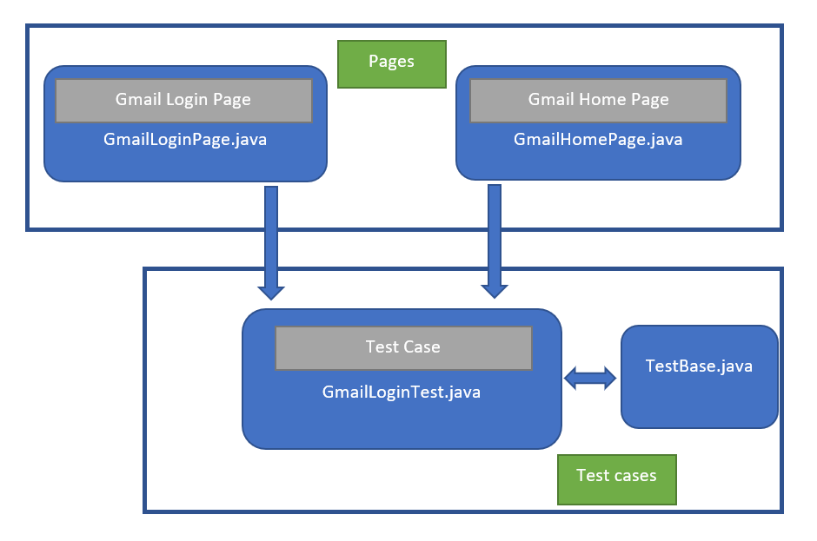
Page Object Model (POM)
Page Object Model, also knows as POM, is a design pattern in Selenium that create an object repository for storing all web elements.
It helps reduce code duplication and improves test case maintenance.
In POM, consider each web page of an application as a class file. Each class file will contain only corresponding web page elements . Using these elements, testers can perform operations on the website under test

Slide 15
Page Object Model (POM)
Why Page Object Model ?
Increasing automation test coverage can result in unmaintainable project structure if locators are not managed in the right way and this can happen due to the duplication of code or mainly due to duplicated usage of locators.
Advantages :
Improved code reusability: The same Page Object class can be used across multiple test cases, reducing the need for code duplication and improving code reusability.
Easy maintenance : POM separates the web elements from the test code, making it easier to maintain the code.
Increases test coverage: POM enables testers to create more tests with less effort.
Better code readability : POM makes the test code mare readable and easier to understand.

Slide 16
Page Object Model (POM)
Rules of Page Object Model :
Rule 1: Every page to be tested should have a Page class.
Rule 2: All the page classes should be in a same package.
Rule 3: Every page class will have a corresponding Test class.
Test class will actually execute the action methods created in page classes.
Rule 4: The driver object will be created in a Base package, TestBase class.
All the class that needs driver object will extends the TestBase class.

Slide 17
TestNG
Introduction: TestNG, short for "Test Next Generation," is a robust testing framework designed for Java applications. Developed by Cedric Beust, it has gained widespread adoption due to its versatility and powerful features, making it a cornerstone for Java test automation.
Key Features:
Annotations: Simplify test configuration using annotations like @Test and @Before/@After.
Parallel Execution: Reduces test suite execution time through parallel test execution.
Parameterization: Enhances test coverage by supporting data-driven testing.
Dependency Management: Ensures a defined order of test execution by managing dependencies.
Test Groups: Categorize and selectively execute tests based on project requirements.

Slide 18
TestNG
Working with Annotations:
@Test: Marks methods as test cases with attributes like priority and dataProvider.
@Before/@After: Set up preconditions and perform cleanup activities.
@BeforeTest & @AfterTest: Setting up and tearing down test environments
@DataProvider: Facilitates data-driven testing.
@Parameters: Passes parameters to test methods

Slide 19
TestNG
Advanced Features and Best Practices:
Parallel Execution: Configurable parallel execution at various levels.
Groups and Dependencies: Control test execution order for selective testing.
Reporting and Logging: Comprehensive test reports for analysis; integrate logging for visibility.
TestNG XML Configuration: Customizable test execution through XML configuration.
Reporting & Logging:
TestNG Reports: HTML reports with detailed information (passed, failed, skipped)
Logging: Debugging and analyzing test execution flow
Visualization: Show examples of generated reports and logs.

Slide 20
Data Driven Framework
A data-driven framework is an automation testing approach where test data is separated from test scripts.
It allows for testing the same functionality with multiple sets of data.
Test data is typically stored in external sources like spreadsheets or databases, and the testing logic remains constant.
This framework enhances test coverage and maintainability by easily accommodating new data sets without code changes.
It's particularly valuable for repetitive tests with varying input values and expected outcomes.

Slide 21
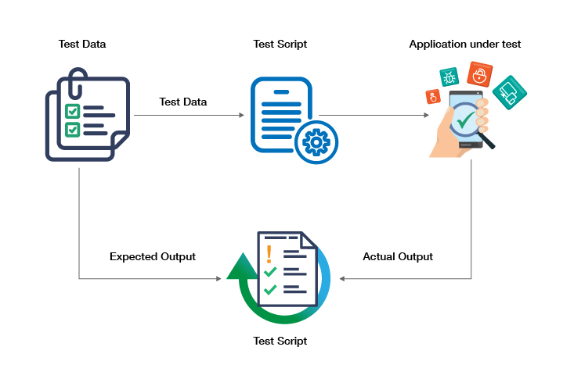
Take a look at the flow diagram below. This replicates a typical data-driven testing framework.
Data Driven Framework

Slide 22
Advantages of using Data Driven testing Approach:
Data Driven Framework
Reusability
Time-efficient
Reduced manual error
Reduced test scripts
Enhanced Clarity
Faster decision making

Slide 23
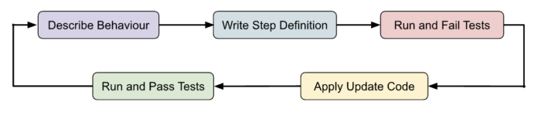
Cucumber
What is Cucumber ?
Cucumber is a testing framework that supports Behavior-Driven Development (BDD). BDD is a software development methodology that encourages collaboration among developers, QA (Quality Assurance) professionals, and non-technical stakeholders in the software development process. Cucumber facilitates the creation and execution of automated acceptance tests written in a natural language format i.e. “Gherkin” language that is easily understandable by both technical and non-technical team members.
Lifecycle of BDD:

Slide 24
How does Cucumber work?
Cucumber BDD framework mainly consists of three major parts:
1.Feature File: Cucumber tests are written in plain text files called feature files stored with the extension – “.feature”. A Feature File can be described to make the documentation more readable. These files describe the behavior and functionality of the software using a specific syntax called Gherkin. Gherkin is a structured language that uses keywords like Given, When, and Then to define the steps of a test scenario.
2.Step Definitions: Each step in a feature file is associated with a step definition implemented in the code. Step definitions define the actions or operations that must be executed for each step of the test scenario. They map the plain text steps in the feature file to the corresponding code implementation.
3.Test Runner File: In Cucumber, the test runner file executes the Cucumber feature files and coordinates the steps defined in those feature files with the corresponding step definitions.

Slide 25
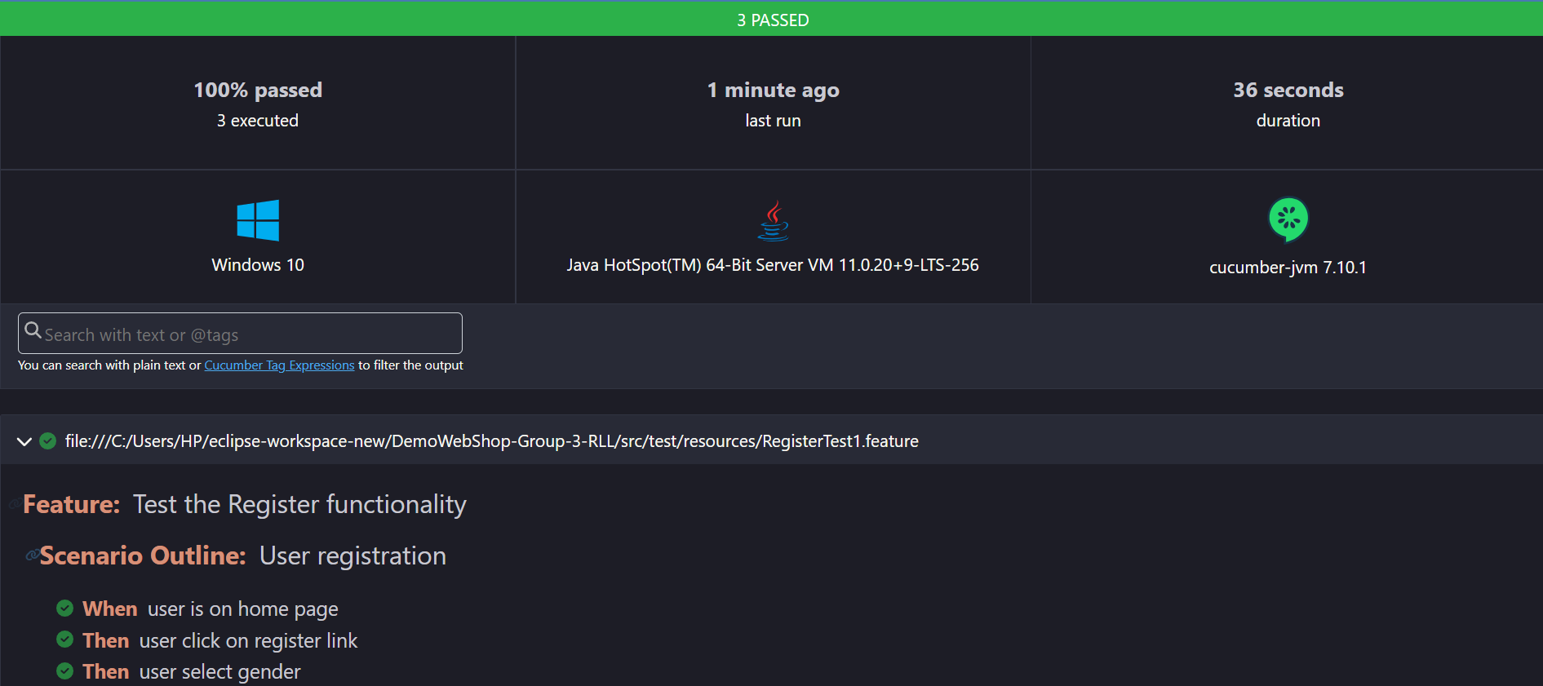
Cucumber Report Screenshots

Slide 26
Extent Report
Extent Report is an open-source, powerful reporting library used for creating beautiful, detailed, and visually appealing reports for automation tests.
How to generate the Extent Report in a Cucumber TestNG Project?
Step 1: Add Extent properties file to the project.
The extent.properties file has to create at the src/test/resources folder of the project. It allows the grasshopper extent report adapter to recognize and read all the properties.
extent.reporter.spark.start=true
extent.reporter.spark.out=Reports/Spark.html
Step 2: Configure Test Runner class to Implement Cucumber Extent Reporter
The next step is to add the extent report adapter to the CucumberOption annotation present in the runner class.
@CucumberOptions(plugin = {"com.aventstack.extentreports.cucumber.adapter.ExtentCucumberAdapter:"})
Extent report will automatically detect features, scenarios, and steps. All these will automatically add to the report.
Step 3: Run Cucumber Test with TestNG to generate Extent Report

Slide 27
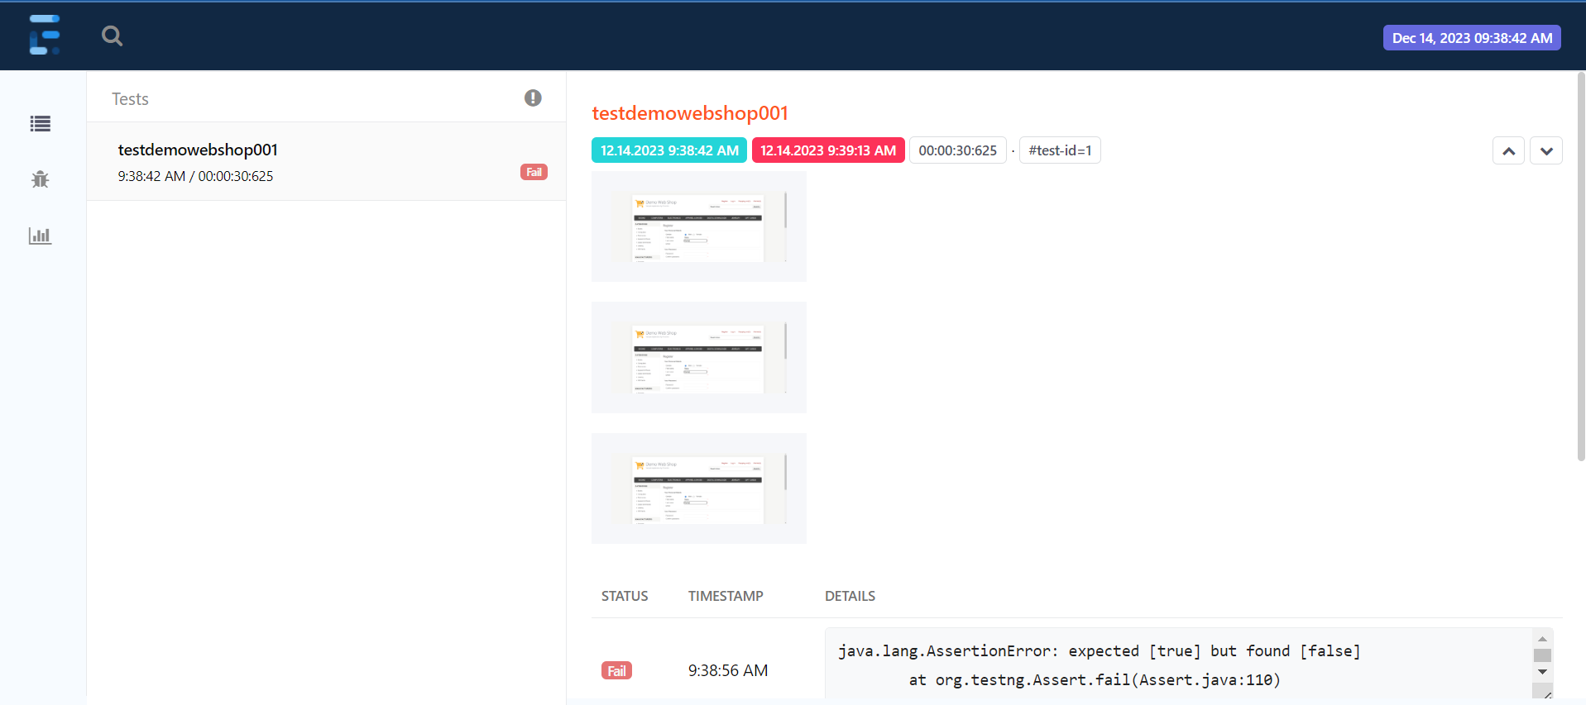
Extent-Report Screenshots

Slide 28
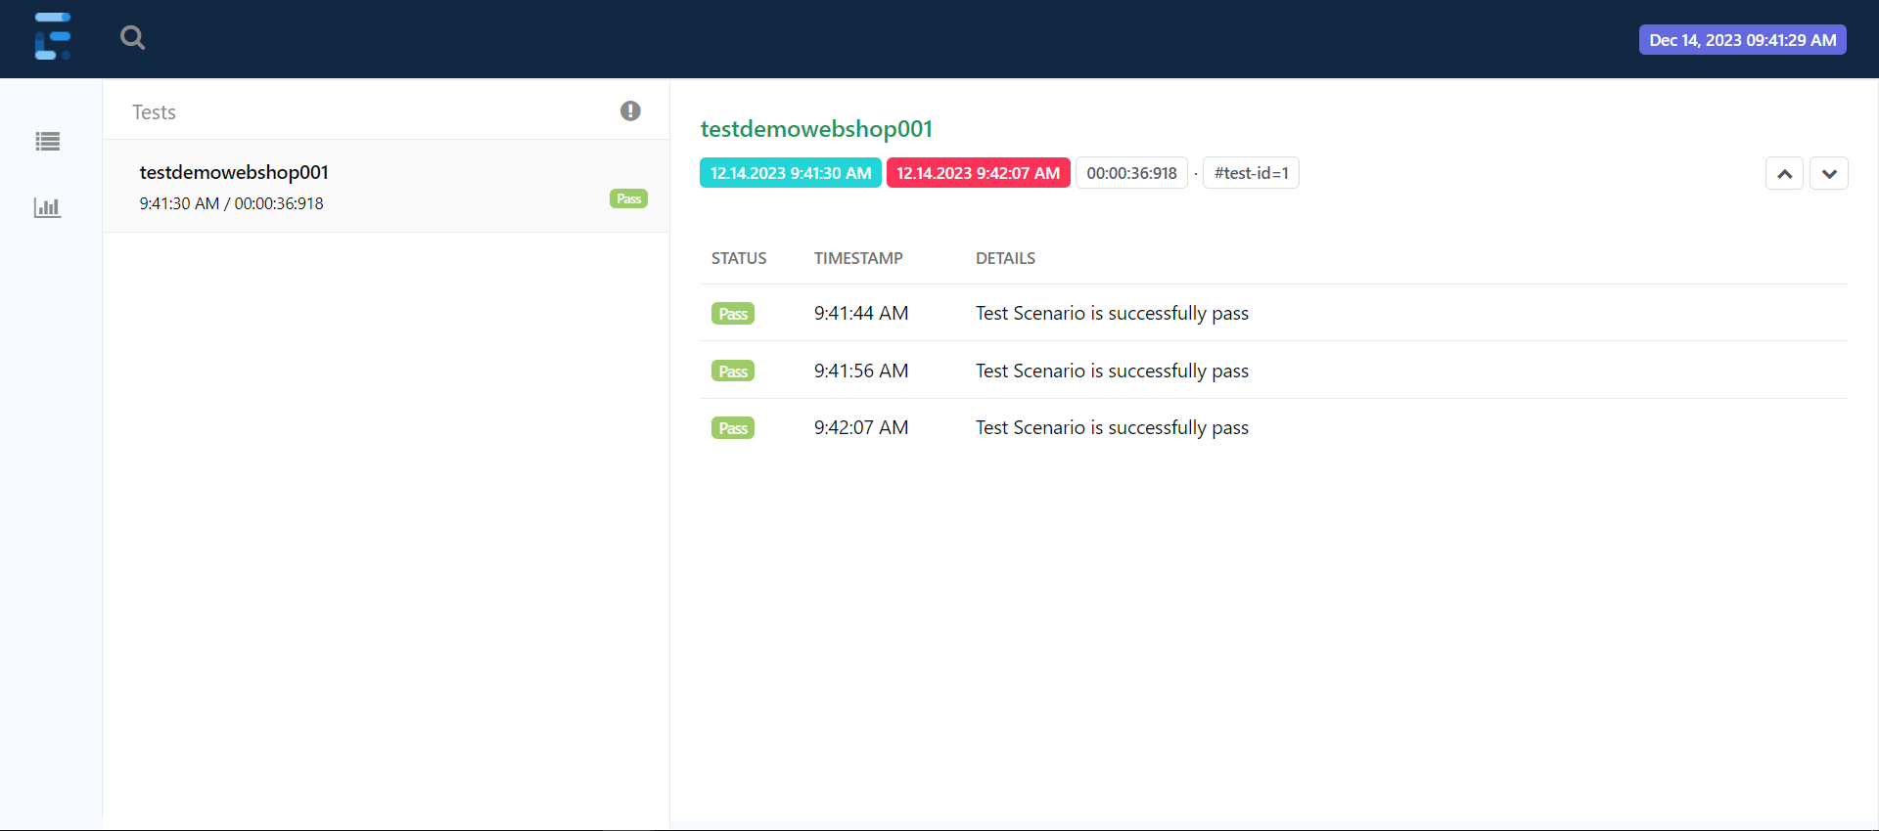
Extent-Report Screenshots

Slide 29
Listeners
TestNG Listeners have the capacity to listen to a specific incident. It is basically an interface that changes the nature of the system. TestNG Listeners are used for logging purposes and creating reports. There are two Listeners in Selenium.
They are listed below −
TestNG Listeners.
WebDriver Listeners.
TestNG can be configured with the Listeners which can change the default behavior of the TestNG. TestNG Listeners are known as iTestListener (a TestNG interface). A java class implements the iTestListeners and at the same time overrides its methods. Each of these methods trigger an event.

Slide 30
Listeners
The functions of TestNG listeners are listed below.
iSuiteListener − This consists of methods onStart() and onFinish(). As a java class implements this listener, TestNG shall call the onStart() and onFinish() methods at the beginning and at the end of the TestNG suite respectively. So before triggering our test suite for execution, the precondition onStart() test method is picked for execution by TestNG. Similarly after the execution of the test suite, post condition onFinish() test method is picked by TestNG.
iTestListener − This is similar in functionality as iSuiteListener. The only difference is that iTestListener is applicable before and after a Test and not Suite. It has seven methods.
onStart − This test method is invoked when the test begins.

Slide 31
Listeners
onFinish − This test method is invoked after all the tests have completed execution.
onTestSuccess − This test method is invoked every time a test is successful.
onTestFailure − This test method is invoked every time a test is unsuccessful.
onTestSkipped − This test method is invoked every time a test is bypassed.
onTestFailedButWithinSuccessPercentage − This test method is invoked every time a test method annotated with successPercentage is not successful. But within the requested success percentage.
iInvokedMethodListener − This is similar in functionality as iTestListener and iSuiteListener. The only difference is that iInvokedMethodListener is applicable before and after every test method. It has two methods.
afterInvocation − This is called after every test method.
beforeInvocation − This is called before every test method.

Slide 32
Assertions
In selenium TestNg,Assertion are verify that actual behaviour of the application under test matches the expected behavior.
They act as a checkpoints within the test cases,ensuring that each step is executed as intended.
TestNg provides various assertion methods to validate different aspects of test case
Types of Assertion
1.Hard Assertion
2.Soft Assertion

Slide 33
Assertions
Commonly used Assertion in Selenium With TestNg:
1. assertEquals
syntax:Assert.assertEquals(expected,actual);
2. assertNotEquals
syntax:Assert.assertNotEquals(expected,actual,message);
3. assertTrue
syntax:Assert.assertTrue(condition);
4. assertFalse
syntax:Assert.assertFalse(condition);
5. assertNull
syntax:Assert.assertNull(object)
6.assertNotNull
syntax:Assert.assertNotNull(object)

Slide 34
Logs
In Selenium WebDriver Page Object Model framework,logging is crucial for capturing information about the test execution process.
And also identifying issues and debugging .
Uses of Log in Selenium WebDriver POM framework:
Debugging
Troubleshooting
Performance Analysis

Slide 35
Jira
JIRA is a project management software developed by the Australian company Atlassian.
The word JIRA is derived from the Japanese word ‘Gojira’, meaning Godzilla.
The software is based on agile methodology.
If you’re wondering what is jira used for, the answer is multiple purposes – bug tracking, issue tracking, and project management.
Many businesses also use JIRA software in non-standard ways as warehouse automation tool, document flow, expenses optimization, and others.

Slide 36
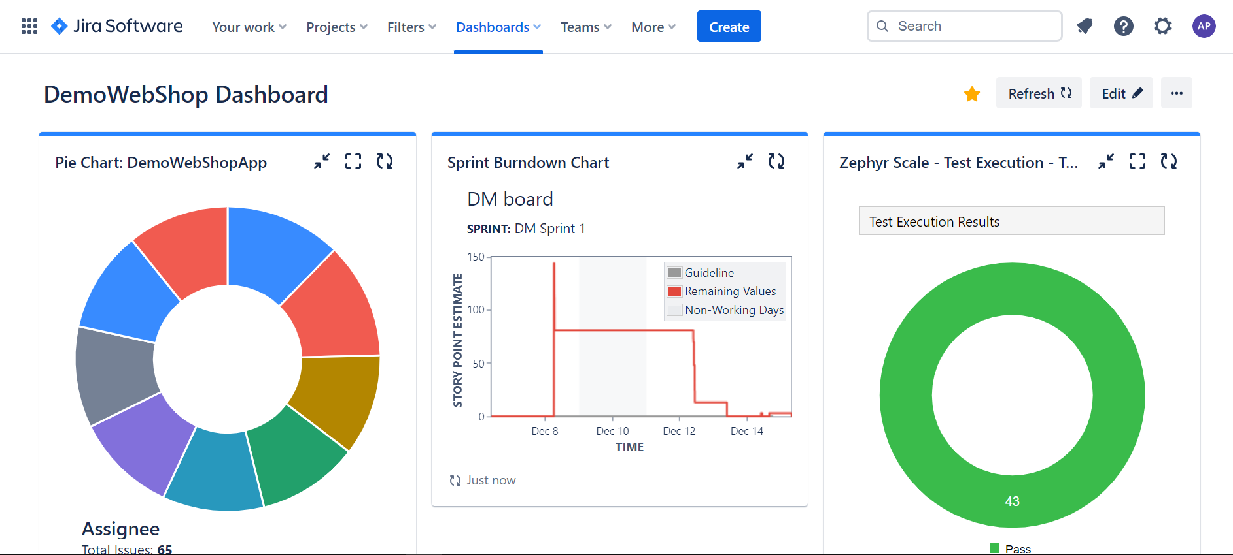
Jira Dashboard Screenshots

Slide 37

Conclusion
In conclusion, automation testing is a critical component of any software development process. It ensures the quality and reliability of applications while reducing the time and effort required to perform manual testing. With the right tools and approach, organizations can improve the speed and accuracy of their testing, catch bugs earlier in the development cycle, and ultimately deliver better products to their customers.

Slide 38

Thank You!

